Slide 1
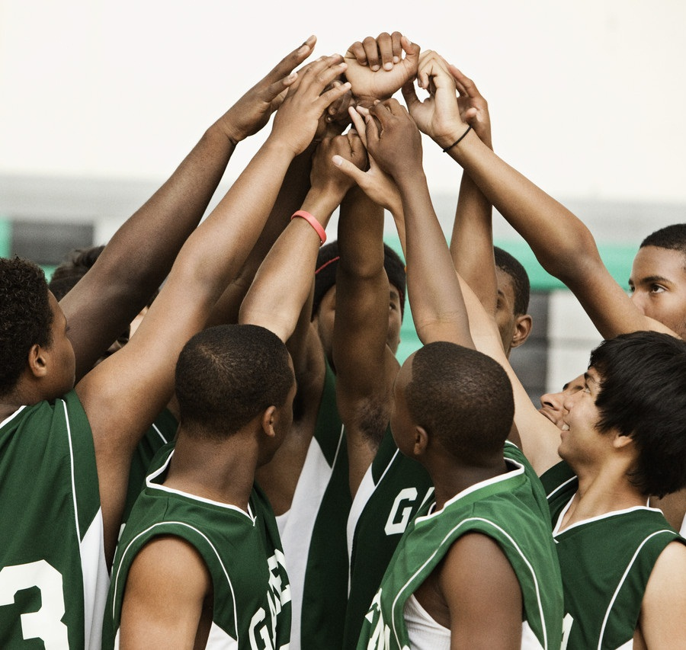
Playing Together
NOTE:
To change images on this slide, select a picture and delete it. Then click the Insert Picture icon
in the placeholder to insert your own image.
The perfect app for sport amateurs

Slide 2
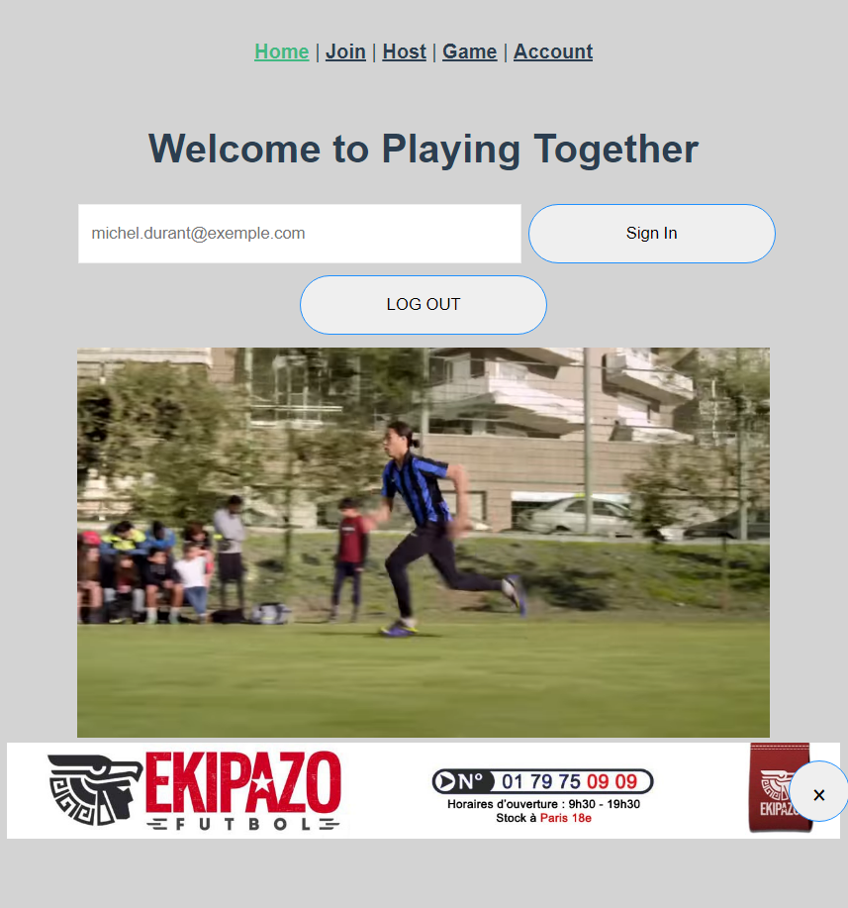
Home Page
Intend :
Welcoming the user with a sport video and an ad for a sport product !
Features :
A log in / log out service
A playable video
An ad that can be closed

Slide 3
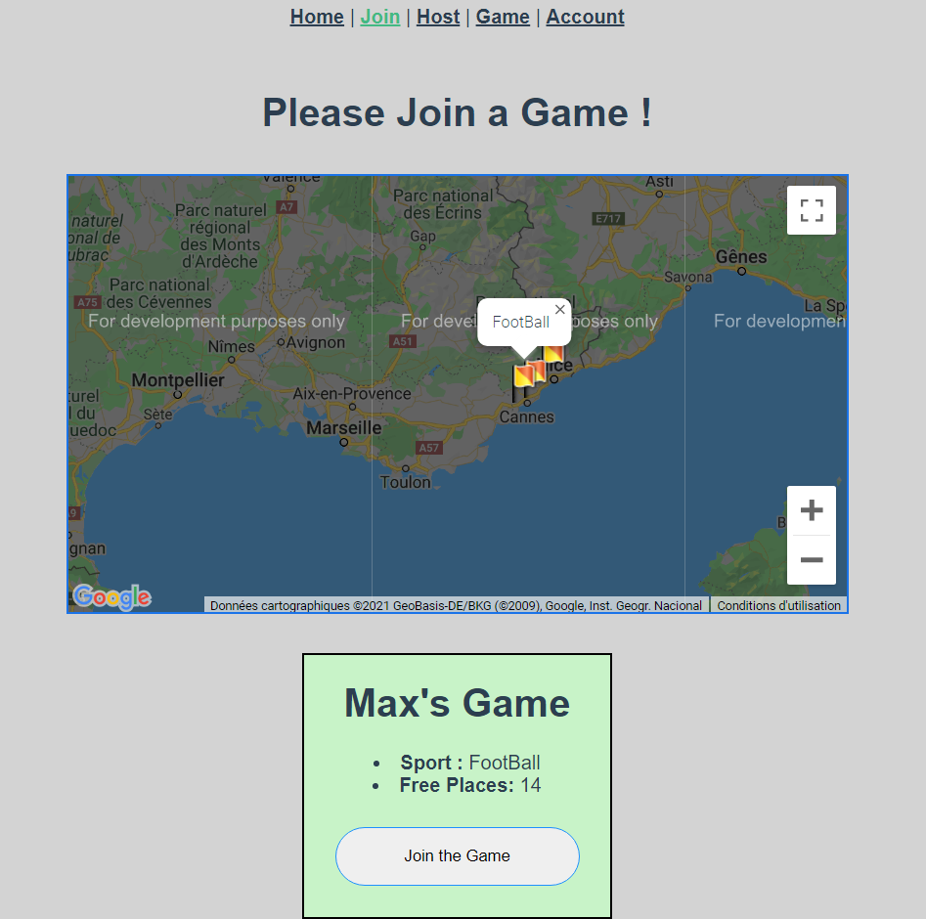
Joining Page
Intend :
This page allows the user to see which games are available and join them !
Features :
A world map that handles drag
Clickable Markers for each event !
An info window for each marker indicating the sport
A Game information box that pops when clicking a marker
A functionnal Join button

Slide 4
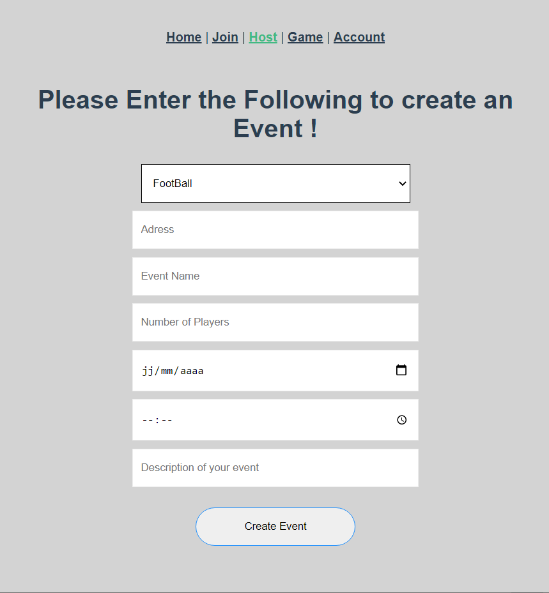
Hosting Page
Intend :
This page allows the user to organize her/his own event !
Features :
A complete form with requirements
A geocoding service that from the address localizes the place
A date and hour input prohibiting organizing in the past
A system of shared data with the Join Page to have the direct adding of the event to the map

Slide 5
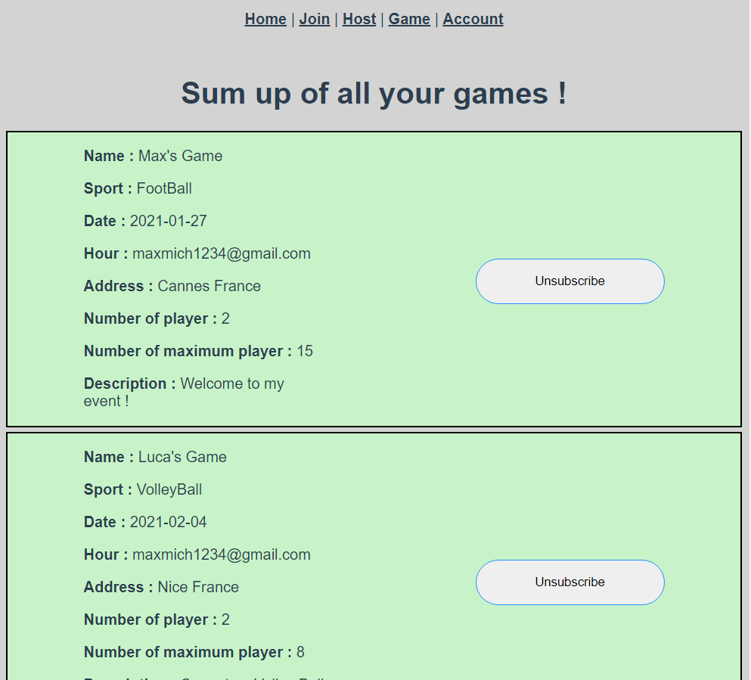
Game Page
Intend :
This shows the user all the games where she/he is registered !
Features :
A window box for each participated game
An unbsubscribe button allowing the user to exit the event

Slide 6
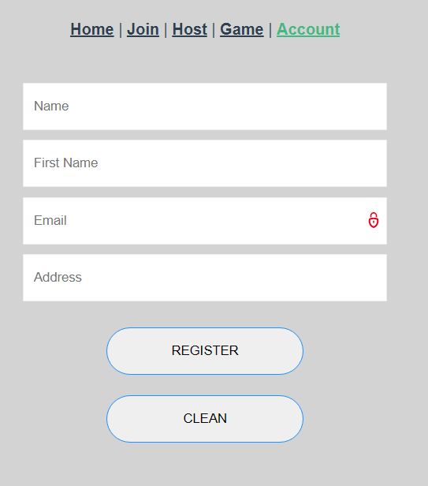
Account Page
Intend :
A simple interface to create your account
Features :
A simple form with all necessary information
A saving of the account in the local storage

Slide 7

Improvement Ideas !
Automatic Deleting of events after the date
List of all registered players to a game
Possiblity of commenting/chatting over events
Possibility for creator of events to delete them

